Slide 1
Deployment and Operations for Software Engineers 2nd Ed
Chapter 6 - Measurement

Slide 2
Outline
Overview
Logs
Metrics
Tracing

Slide 3
Context
Your system is in operation.
Operational data is being gathered
Why?

Slide 4
Purposes of gathering operational data
Generate alerts. Measurements are used to generate alerts to indicate a serious problem with a system in operation.
Forensics. When a problem has occurred, it must be identified. Logs collected by the system in response to events are used to identify the problem.
Performance. Understanding the end-to-end behavior of a system in response to requests shows where the system spends time.

Slide 5
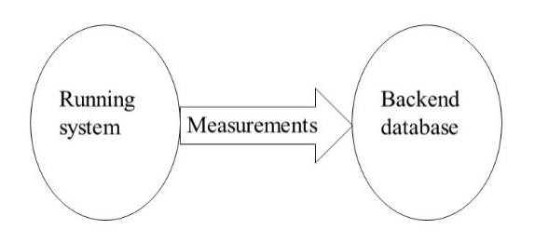
Measurement architecture
Information is collected in a variety of locations within your system.
It should be moved to a central location for analysis.
This is typically a time series database.

Slide 6
Sources of measurement data
The measurement data comes from two sources:
The infrastructure that monitors utilization,
The logs produced by the services.
In both cases, there is a backend specific service that
gathers the information,
Reformats it for the backend,
passes it to the backend.

Slide 7
Activities of backend
The backend sends an alert based on a collection of rules similar to autoscaling rules.
Displays a dashboard that allows an analyst to quickly determine whether there is a problem.
Supports various types of analysis of the data collected.

Slide 8
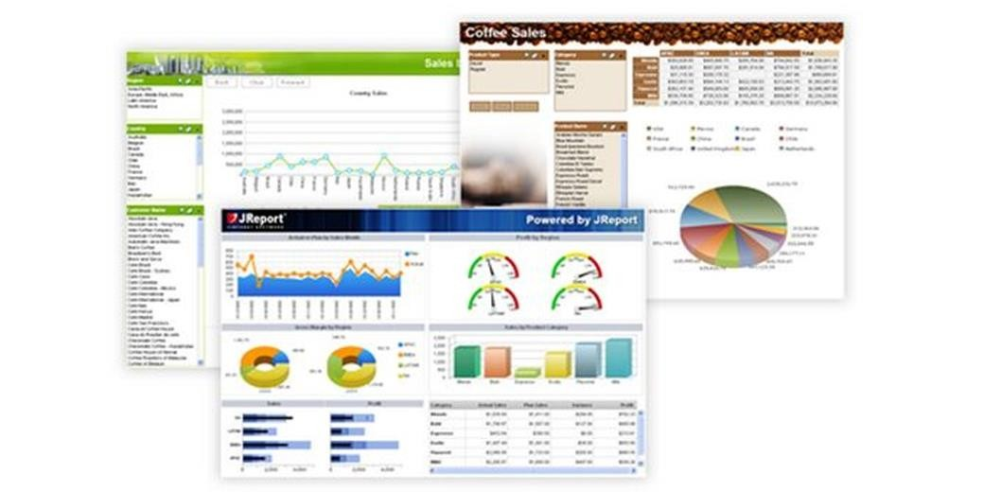
Sample dashboard

Slide 9
Time readings in a distributed system
Clocks on computers drift. ~1 second every 12 days.
Clock measurement based on a single computer will be accurate to within clock resolution.
Clock measurements taken across multiple computers cannot be used to reliably determine latency or sequence of events.

Slide 10
Time accuracy
Network time protocol is accurate to within 1 millisecond on a local network and within 10 milliseconds on a public network.
Compare these times to the time taken for messages or memory references. They are much larger.
Tracing uses request IDs to identify sequences of activities.
GPS time is accurate to about 100 nanoseconds but requires access to satellites.
Atomic clocks have no measurable drift but are very expensive.

Slide 11
Discussion questions
What are some specific functions a backend database provides. See Splunk or Logstash for examples.
How could you compute the difference in clock readings between your smart phone and your laptop? Remember that it takes time to send a message.

Slide 12
Outline
Overview
Logs
Metrics
Tracing

Slide 13
Log entry
A log entry is generated by a service in response to some event.
Entry/exit
Error detection
Logs are used for forensic purposes. That is, finding the source of a problem.
Contents of a log entry are typically
Time stamp
Identifying information
Reason for log entry
Variable values
…

Slide 14
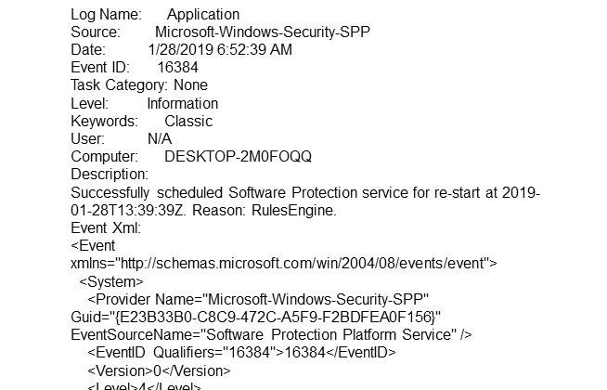
Sample log from Windows

Slide 15
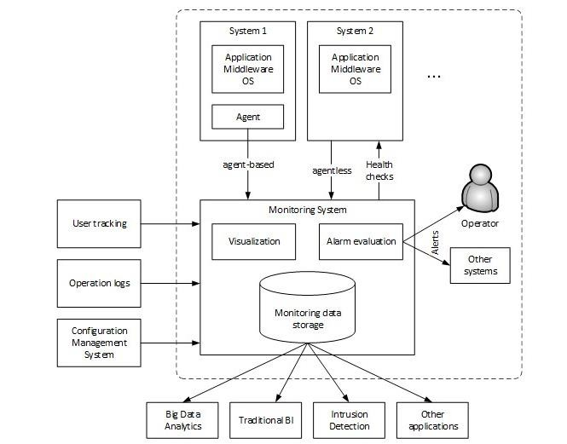
Moving log files to backend
Logs are written to known location in the file system
An agent runs on server.
Agent sends logs periodically to backend.
It can then clean up the
log file so it doesn’t get too large.

Slide 16
Discussion questions
How does the service decide to generate a log entry?
If time is inaccurate across computers, why put a time stamp in a log entry?

Slide 17
Outline
Overview
Logs
Metrics
Tracing

Slide 18
Metric collection
Metrics measure utilization of resources by VMs or containers.
Logs are service specific. You know which service generated the log entry
Metrics are resource specific. They can be tied to particular VM or container but not to service running inside the VM or container.
Metrics are automatically collected by the infrastructure.
A backend ingestion process takes the data collected by the infrastructure and transfers it to the backend database.

Slide 19
Metric based information
Utilization has the form value/time period. It only makes sense over a time period.
Knowing that at time X, the CPU was busy does not tell you whether the CPU is overloaded. As long as it is alive, it will be busy a some point.
You need to know that over a time period, the CPU was busy for some percentage of the period. Similarly for other resources.
The infrastructure will sample the VM or container to get an instantons reading and then aggregate these readings to get utilization.

Slide 20
Discussion questions
Determine the information collected by AWS CloudWatch or your equivalent cloud provider and how that information can be ingested by Logstash.
How do you determine the correct time interval to collect utilization information?

Slide 21
Outline
Overview
Logs
Metrics
Tracing

Slide 22
Tracing information
Logs show single events. Traces show end to end sequences.
A request is assigned an ID when it enters the system. The Windows log sample has an entry “Event ID”.
This request ID is passed to each service involved in satisfying the request. This yields a request sequence.
Request IDs are saved in the log entries of a service.
Subsequences are called spans.

Slide 23
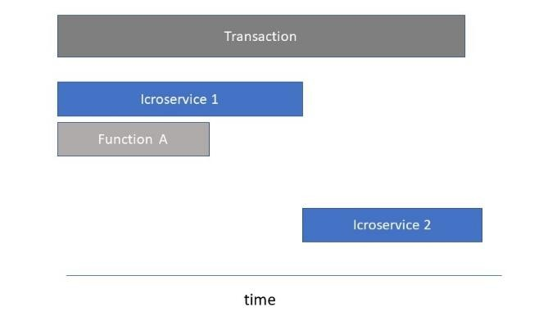
Span example
Aggregating multiple requests gives information about where requests spend time. I.e. it helps to find bottlenecks.

Slide 24
Context
The request ID can also be used to identify the context of a request.
Context can be used
For routing
For A/B or canary testing
For system identification within a family of systems.
For traffic prioritization

Slide 25
Discussion questions
What are the different methods available to an analyst to determine performance issues?
How would context be used to support canary testing?

Slide 26
END OF CHAPTER 6

